Slide 1
Integration R with Tableau
Dr.Parvathi.R
Professor,SCSE,
VIT,Chennai

Slide 2


Introduction to Tableau and R Integration
What are the benefits of using Tableau and R integration?
Access R packages or functions for quantitative analysis
Take advantages of Tableau's data visualization capacities

Slide 3
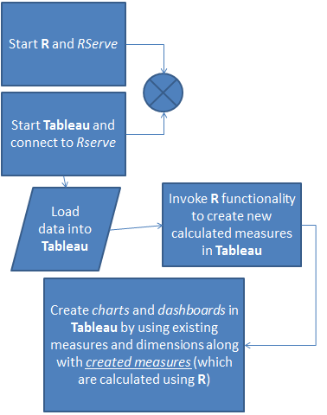

Slide 4
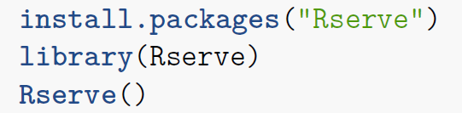

Introduction to Tableau and R Integration
How is Tableau integrating with R?
Install Rserve Package
Create Calculation Field in Tableau
Use one of the four functions:
SCRIPT_BOOL: Return a Boolean
SCRIPT_INT: Return an Integer
SCRIPT_REAL: Return a Real
SCRIPT_STR: Return a String
Input Data
Pass R Script and Data into R
Rserve
Output Data
Interactive Data Visualization

Slide 5
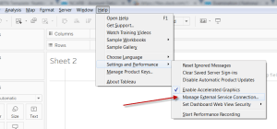
Set Up the External Connection in Tableau
There is one more thing you will need to do prior to writing in R in Tableau, but to do this you will need to switch over to Tableau. Tableau needs to have the external connection set-up in order to run R.
Go to the Help -> Settings and Performance -> Manage External Connections.

Slide 6
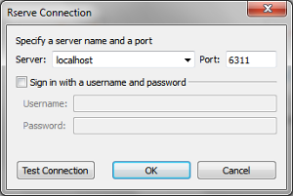
Host and port
In the pop-up, type in localhost for the Server name. Click on Test Connection to verify it is now connected.

Slide 7
Start Using R Integration
The integration uses calculated fields to pass R code. There are four different types of calculations used in the R integration:
SCRIPT_BOOL
SCRIPT_INT
SCRIPT_REAL
SCRIPT_STR

Slide 8
Start Using R Integration
Which one you use depends on what type of value you expect to get as a result of your R Code.
SCRIPT_BOOL would be used if you expected a TRUE/FALSE value returned.
SCRIPT_INT would be used if you expected to have an integer returned.
SCRIPT_REAL would be used if you expected a numeric value returned.
SCRIPT_STR would be used if you expected a string value to be returned.

Slide 9
Simple display
SCRIPT_STR('hello <- "Hello World"',ATTR([F1]))

Slide 10
K means algorithm
SCRIPT_INT(‘set.seed(42);
result <- kmeans(data.frame(.arg1,.arg2,.arg3,.arg4), 3);
result$cluster;',
SUM([petal_length]), SUM([petal_width]),SUM([sepal_length]),SUM([sepal_width]))

